Slide 1
LCAP 2017
Budget Summary Guidelines and
Examples of Writing Expenditures for Goals Actions and Services
in the new LCAP Template

Slide 2
CCSESA - November 2016
LCAP Section 1: Plan Summary - Budget Summary

Slide 4
Political Context
“As the comprehensive educational plan for the district, the
LCAP should account for nearly all education-related spending, including all supplemental and concentration – and most base – funding.”
(Keeping the Promise of LCFF, Public Advocates, April 2016)

Slide 5
What to do before completing section
Complete Budget Summary after Goals, Actions, and Services section
Use FCMAT LCFF Calculator to estimate LCFF revenues (based on latest information available)
Build district budget
Draft LCAP - Estimate budget based on most recent information
Final LCAP - Adopted budget
Other things to consider:
Estimated costs related to school operation (administrative costs, personnel, systems, overhead, etc.)
Contributions to other programs/requirements not included in LCAP

Slide 6
“...the LCAP must describe, for the school district and each school within the district, goals and specific actions to achieve those goals for ALL STUDENTS
AND EACH STUDENT GROUP identified by the Local Control Funding Formula (LCFF) (ethnic, socioeconomically disadvantaged, English learners, foster youth, pupils with disabilities, and homeless youth), for each of the state priorities and any locally identified priorities.” (Emphasis Added)
Budget Summary Template Instructions
6

Slide 7
Total LEA General Fund Budget Expenditures for the LCAP Year: This amount is the LEA’s total budgeted General Fund expenditures for the LCAP year. The LCAP year means the fiscal year for which an LCAP is adopted or updated by July 1. The General Fund is the main operating fund of the LEA and accounts for all activities not accounted for in another fund…
Total of ALL General Fund Expenditures (Unrestricted and Restricted)
Total Funds Budgeted for Planned Actions/Services to Meet the Goals in
the LCAP for the LCAP Year: This amount is the total of the budgeted expenditures associated with the actions/services included for the LCAP year from all sources of funds, as reflected in the LCAP. To the extent actions/services and/or expenditures are listed in the LCAP under more than one goal, the expenditures should be counted only once.
Total of all unique amounts for LCAP actions/services in current year
Budget Summary Template Instructions
7

Slide 8
Description of any use(s) of the General Fund Budget Expenditures
specified above for the LCAP year not included in the LCAP: Briefly describe expenditures included in total General Fund Expenditures that are not included in the total funds budgeted for planned actions/services for the LCAP year.
Briefly describe where the funds are going if they are not described in the LCAP. This is an opportunity to summarize operational expenses and call out any particular items that may be useful for stakeholders to know.
Total Projected LCFF Revenues for LCAP Year: This amount is the total amount of LCFF funding the LEA estimates it will receive pursuant to EC sections 42238.02 (for school districts and charter schools) and 2574 (for county offices of education), as implemented by EC sections 42238.03 and 2575 for the LCAP year respectively.
Total of all LCFF Revenue (Base, Supplemental, and Concentration Grants, Transportation, TIIG, MSA)
Budget Summary Template Instructions
8

Slide 9
SACS Form 01
Page 1
9) TOTAL EXPENDITURES
Column (F)
++ Plus ++
Transfers Out
Other Uses
Total $ Budgeted for Actions / Services in LCAP Year (All Sources)
Explain use of funds not included in LCAP Actions / Services
SACS Form 01
Page 4
Subtotal, LCFF Sources
-- Minus --
Transfers to Charter Schools in Lieu Property Taxes
9

Slide 10
Completing the Budget Summary
Total General Fund Budgeted Expenditures
281,601,023.00

Slide 11
Completing the Budget Summary
Total General Fund Budgeted Expenditures
281,601,023.00

Slide 12
Completing the Budget Summary
Total Funds Budgeted for Planned Actions/Services in LCAP Year
Note:
Total of all amounts budgeted actions/services for 2017
If amounts are duplicated in other Actions/Services, ONLY COUNT ONCE

Slide 13
Completing the Budget Summary
Total Projected LCFF Revenues
220,789,795.00

Slide 14
Completing the Budget Summary
Description of Budgeted Expenditures Not Included in LCAP
Potential Items to Include in Brief Description
Cost of base program
General cost of overhead
Contributions to program not included in LCAP
Mandatory contributions to Routine Restricted Maintenance
Anything else that might:
Help stakeholders understand overall cost of education
Be useful for district to share
Could be opportunity rather than challenge
Merriam-Webster Definition
Brief: using only a few words
14

Slide 15
-
Meets Basic Requirements
Short description statements, general dollar figures
Teacher, staff, and administrator salary and benefits account for nearly 90% of the district’s general fund expenditures (roughly $90 million). Other key expenditures include general overhead($1 million) expenses, transportation ($800 thousand), maintenance ($4 million), and contributions to special education ($4 million).
Exceptional LCAP Communication
Informative statements which are helpful to stakeholders
The district strives to implement its strategic vision toward improving student outcomes while maintaining fiscal responsibility. An overwhelming majority of district expenditures (88%) are used to hire teachers and staff who deliver services to students. LCAP initiatives account for only $3.5 million of overall cost of salaries and benefits ($88 million). The district is facing increased costs related to pensions (increasing $1.3 million per year), persistent underfunding of our special education program ($16 million), and ...
What to Avoid
A spreadsheet of numbers with no context
15
CCSESA - November 2016

Slide 16
Budget Summary: COE Review
Did the district provide an explanation of how funds are being used outside those Actions/Services listed in the LCAP?
Does the explanation provide sufficient information to be understandable to a
reasonable stakeholder?
How much detail was provided?
#1
How much detail is actually required?
What does “Briefly describe any…” mean?
16

Slide 17
Budget Summary: COE Review
Was a dollar amount provided?
#2
Verify total budgeted expenditures for Actions/Services in current LCAP Year.
17

Slide 18
Budget Summary: COE Review
Was a dollar amount provided?
#3
Verify amount against District’s 2017-18 Adopted Budget.
SACS Form 01
SACS Form 01
Page 1
9) TOTAL EXPENDITURES
Column (F)
++ Plus ++
Transfers Out
Other Uses
18

Slide 19
Budget Summary: COE Review
Was a dollar amount provided?
Verify amount against District’s 2017-18 Adopted Budget.
SACS Form 01
SACS Form 01
Page 4
Subtotal, LCFF Sources
-- Minus --
Transfers to Charter Schools in Lieu
#4
Property Taxes

Slide 20
Budget Summary: COE Review

Slide 21
Budget Summary Example:
The following slides are from COE approval calibration meetings
Some typical expenditures not included in the LCAP
General Instructional Supplies
Deferred Maintenance
Copier leases and maintenance agreements
General operations costs (water, power, etc)
Some districts have not included the base instructional program in their LCAPs and written plans focused on the use of supplemental funds to serve unduplicated students. This is not recommended. If your LEA does not include base program, the costs of the base program would be indicated in the summary box describing expenditures not in the LCAP

Slide 22
District General Fund Budget
CCSESA - January 2017
Notes:
Slides 51 through 53 is a test of “Approvable” or “Not Approvable”.
Total budget to be entered into the “Total General Fund Budget Expenditures for LCAP Year” box would be the $48,767,549 amounts from line B.9) in the Total Fund column.

Slide 23
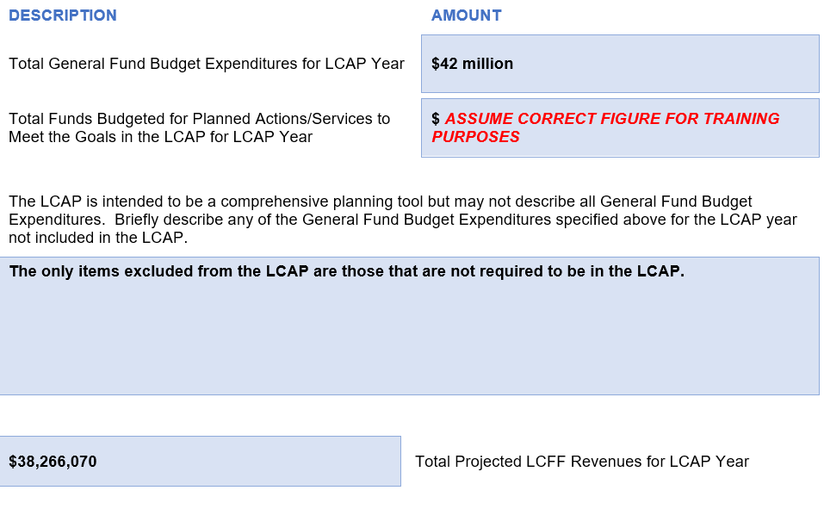
Approvable – Non Approvable?
42 million is probably not approvable based on the information available. The total general fund budget is $48,767,549 so a variance of over $6.7 million is quite significant… over 13%.
$34 million
This explanation is clearly inadequate. It should contain some description of how the dollar difference between total expenditures (1st box) and LCAP Action expenditures (2nd box) is being used.
CCSESA - January 2017

Slide 24
Goals Actions and Services
From the LCFF Regulations:
“...the LCAP must describe, for the school district and each school within the district, goals and specific actions to achieve those goals for ALL STUDENTS AND EACH STUDENT GROUP identified by the Local Control Funding Formula (LCFF) (ethnic, socioeconomically disadvantaged, English learners, foster youth, pupils with disabilities, and homeless youth), for each of the state priorities and any locally identified priorities.” (Emphasis Added)
Expenditures for goals actions and services are estimated
Be sure to clearly name the expense in a manner that stakeholders will understand in additions to providing SACS budget references
Separate costs of salary and benefits
If there is a position described in the LCAP i.e. TOSA, that is already included in “Certificated salaries and benefits” described in a prior action, include the specific cost of the position, but be sure to also indicate that the amount is already included in a prior action

Slide 25
ACTIONS/SERVICES
2017-18 |  | 2018-19 |  | 2019-20
☐ New ☐ Modified X Unchanged |  | ☐ New ☐ Modified X Unchanged |  | ☐ New ☐ Modified X Unchanged
Recruit, hire and retain a diverse group of highly qualified teachers who are skilled in closing the achievement gap while all students improve. Maintaining an average class size of 24:1 in grades TK-3 and 29:1 in grades 4-12 Certificated Salary (a) and Benefits (b): (1000 and 3000) Certificated Signing bonuses (c) (1110) (Title II)
BUDGETED EXPENDITURES
2017-18 |  | 2018-19 |  | 2019-20
Amount | $28,327,361.00 Total = a + b (a)$19,545,879 (b) $ 8,781,482 (c) $14,000.00 | Amount | $28,946,691.00 Total = a + b (a)$19,973,216 (b) $ 8,973,475 (c) $14,000.00 | Amount | $29,521,011.00 Total = a + b (a)$20,369,497 (b) $ 9,151,514 (c) $14,000.00
Source | LCFF BASE (0000) Title II (4035) | Source | LCFF BASE (0000) Title II (4035) | Source | LCFF BASE (0000) Title II (4035)
Budget Reference | 010-0000-0-xxxx-xxxx-xx-1000 010-0000-0-xxxx-xxxx-xx-3000 060-4035-0-1111-00-1110-1000 | Budget Reference | 010-0000-0-xxxx-xxxx-xx-1000 010-0000-0-xxxx-xxxx-xx-3000 060-4035-0-1111-00-1110-1000 | Budget Reference | 010-0000-0-xxxx-xxxx-xx-1000 010-0000-0-xxxx-xxxx-xx-3000 060-4035-0-1111-00-1110-1000
Salary, benefits, and other costs separated from total

